Slide 1





The
Accounting
Cycle
Group Members:
1807_Fahmida Akter
1826_Ahalun Meghobati
1837_Abrarul Hasan
1840_Dipraj Barua
1839_Mohammad Shaharier
1819_Chaity Bhadra
Represent by
Group - 10

Slide 2











Step 1 :
Identify and analyze
transaction.
Step 8 :
Close the books.
THE
ACCOUNTING
Step 2 :
Record transaction
in journal.
CYCLE
Step 7 :
Create Financial Statement.
Step 3 :
Post transaction to general ledger.
Step 6 :
Adjust Journal Entries
and fix error.
Step 4 :
Step 5 :
Determine unadjusted
Trial balance.
Analyze the worksheet.

Slide 3
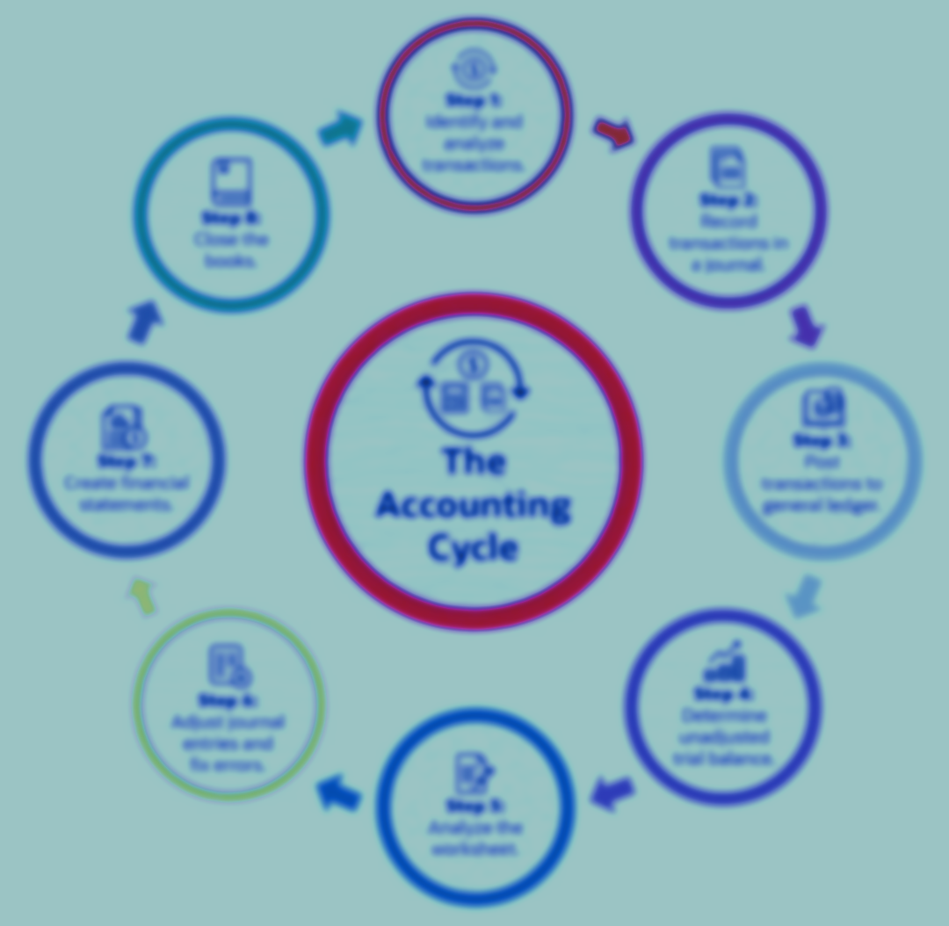
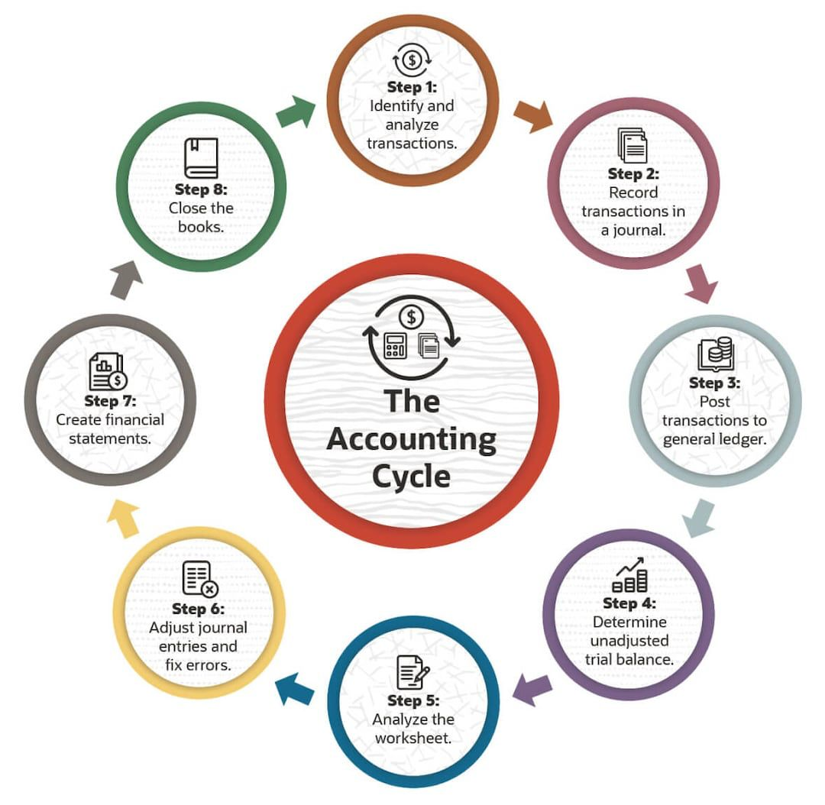

Introduction
The accounting cycle is a collective process of identifying, analyzing, and recording the accounting events of a company.
It is a standard 8-step process that begins when a transaction occurs and ends with its inclusion in the financial statements and the closing of the books.

Slide 4
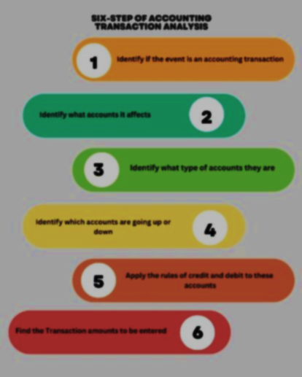
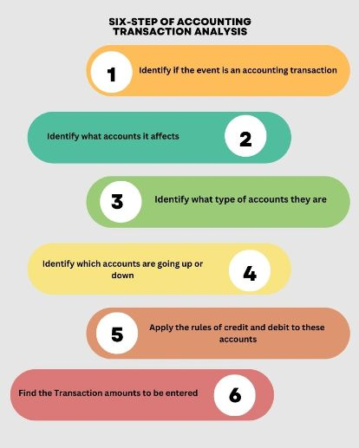
Step-1
Identify and analyze transactions
Identification and analysis of transactions in accounting is an essential part of the accounting process.
Whenever a business starts to keep chronological records of its business transactions, it aims to maintain books of accounts that are free of errors and quickly help access its business performance.
In this article, you will find what a transaction is and how the identification and analysis of transactions In Accounting is processed.

Slide 5
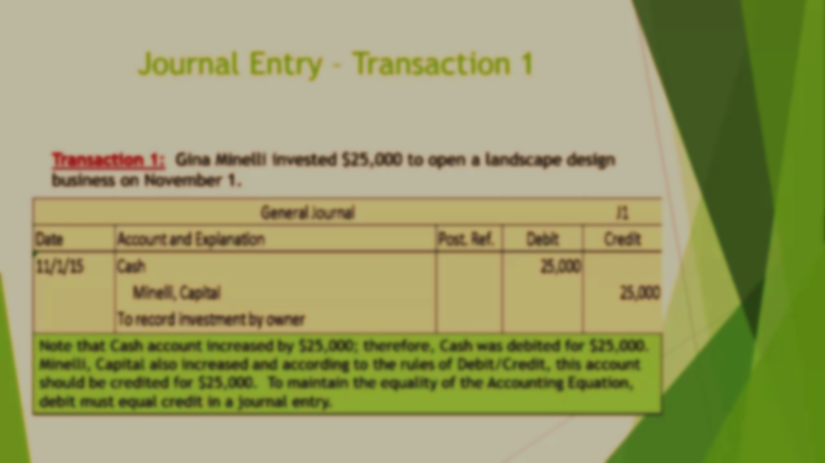
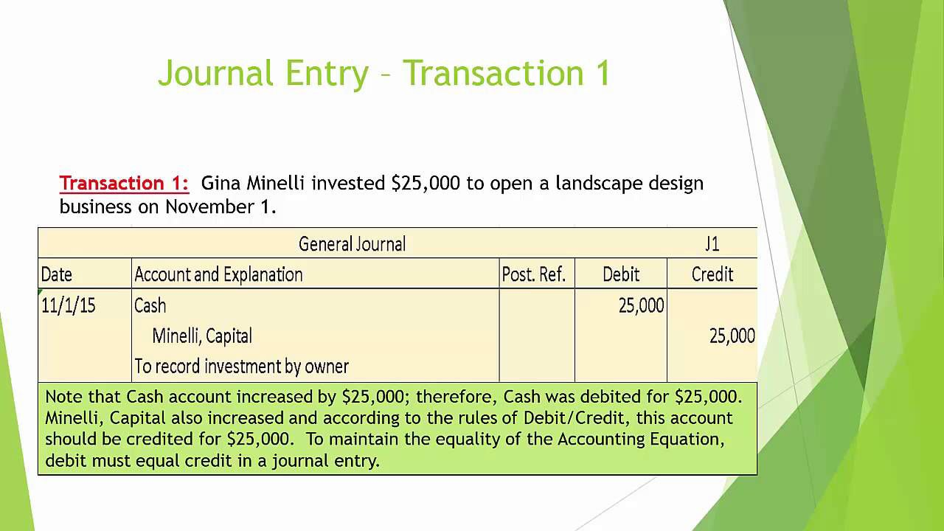
Step-2
Record transaction in a journal
Journalizing transactions is the crucial first step in the accounting cycle.
A journal entry records a business transaction in the accounting system for an organization. For example, when a business buys supplies with cash, that transaction will show up in the supplies account and the cash account. A Journal entry has the following components-
The date of the transaction.
The account name and number for each account impacted.
The credit and debit amount.
A reference number that serves as a unique identifier for the transaction.
A description of the transaction.

Slide 6
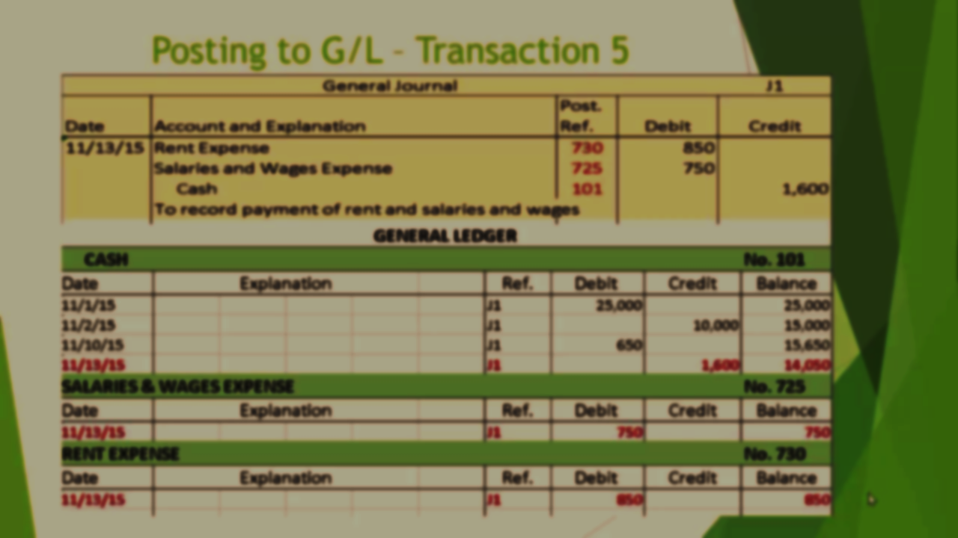
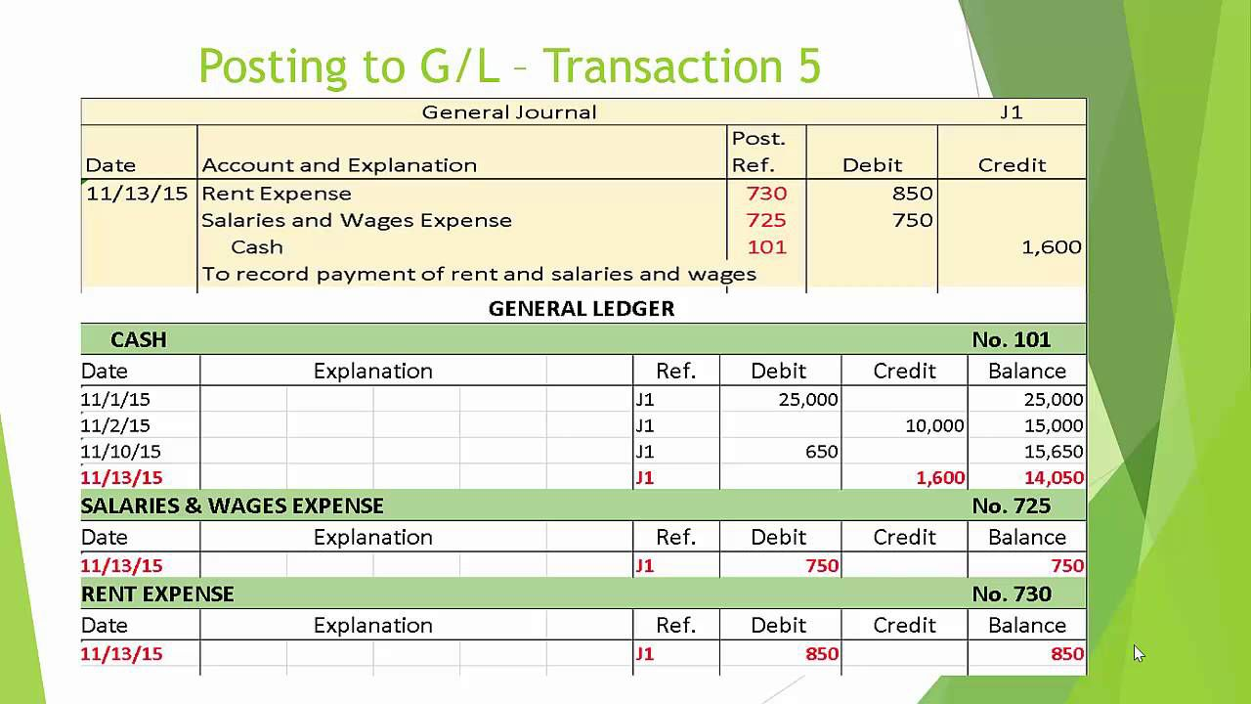
Step-3
Post transaction to general ledger
The third step of the accounting process is to post those journal entries into ledger accounts.
Thus, the bookkeeper/accountant must put the recorded transaction to the general ledger account.
The transactions find a proper breakdown within it, and the accounting events are easily identifiable as a separate account.
This part of the accounting cycle includes posting all the Debit and Credit transactions into a statement belonging to a ledger account as shown in the below image.

Slide 7
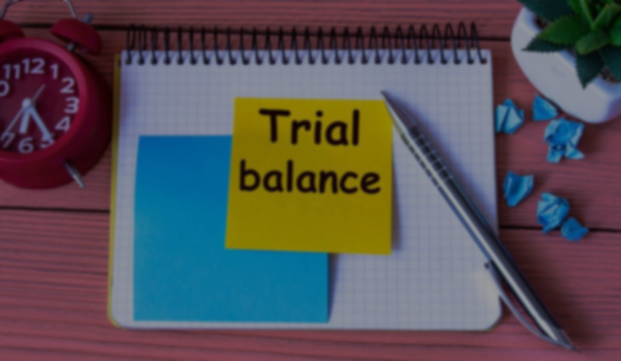
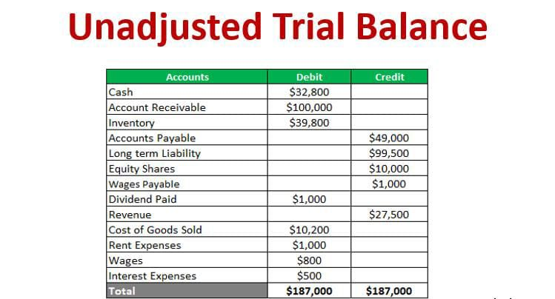
Step-4
Determine unadjusted trial balance
In this step, you must list all ledger accounts with closing balance posted from individual ledger accounts statement (discussed above).
The format of the trial balance consists of the Debit column and Credit column in which the closing balance of each ledger accounts will be posted.
After posting the closing balance of all the ledger accounts, the debit balance should match with the credit balance. This is the primary source for preparing the final accounts and all other financial statements.

Slide 8
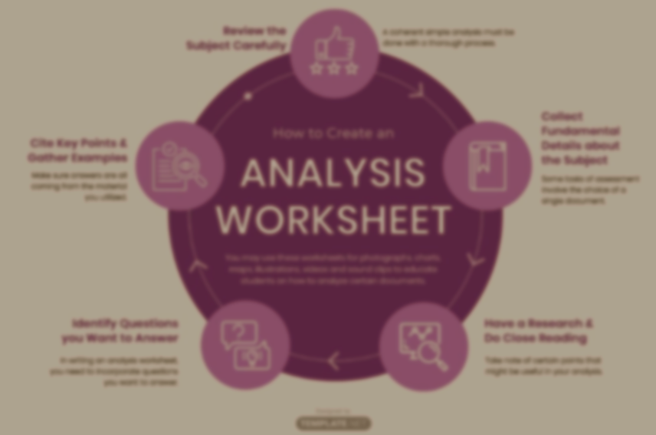
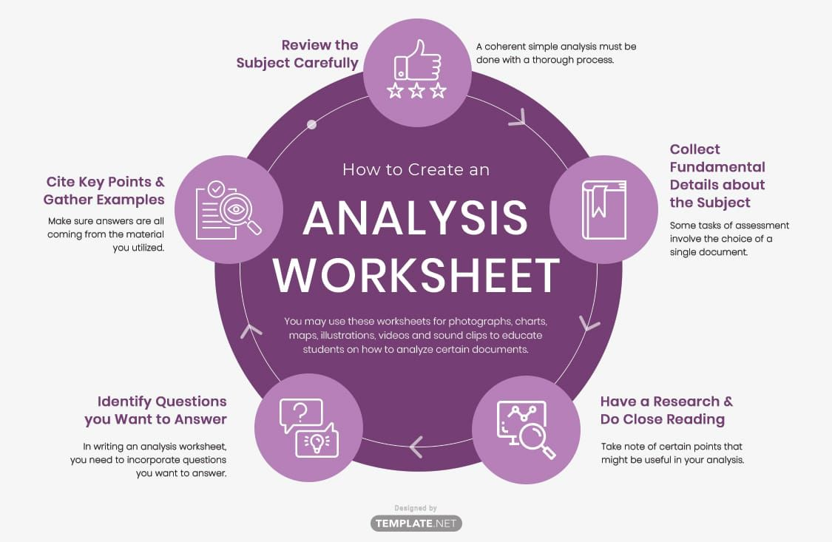
Step-5
Analyze the worksheet
Worksheet: When the debits and credits on the trial balance don’t match, the bookkeeper must look for errors and make corrective adjustments that are tracked on a worksheet.
This step is only necessary when the ending balance does not match up. Accounting errors usually happen from mathematics slips incorrect, posting or in accurate transcription.
Whatever the scenario a book keeper needs to find out where the error took place.

Slide 9
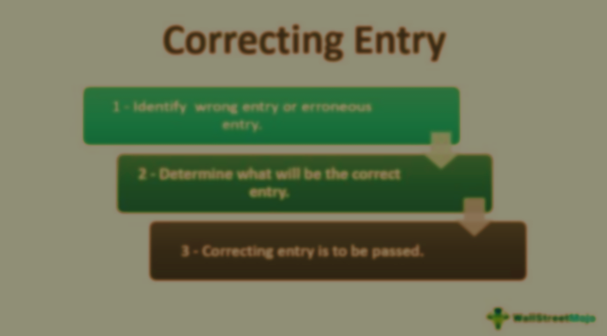
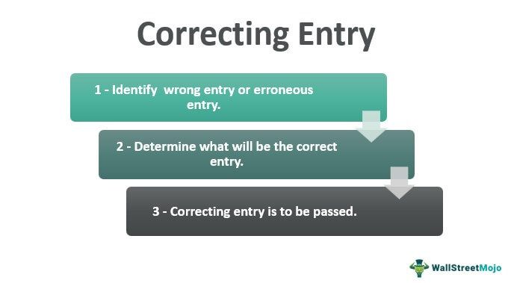
Step-6
Adjust journal entries and fix errors
There are two ways to make correcting entries: reverse the incorrect entry and then use a second journal entry to record the transaction correctly, or make a single journal entry that, when combined with the original but incorrect entry, fixes the error.
Enter the difference (adjustment amount) in the correct account(s).
If the original entry was too low, increase an account. If the original entry was too high, decrease an account.

Slide 10

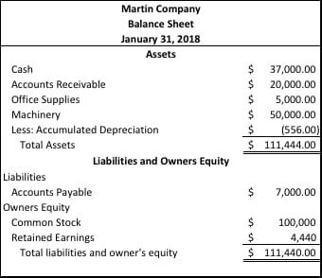
Step-7
Create financial statements
A financial statement is a formal document that presents the financial position and performance of a business or organization. It provides important information about the company's revenues, expenses, assets, liabilities, and shareholders' equity. The main types of financial statements are:
Income Statement: This statement shows the revenues, expenses, and resulting profit or loss for a specific period of time.
Balance Sheet: The balance sheet provides a snapshot of the company's financial condition at a specific point in time.
Cash Flow Statement: This statement tracks the inflows and outflows of cash during a specific period.

Slide 11
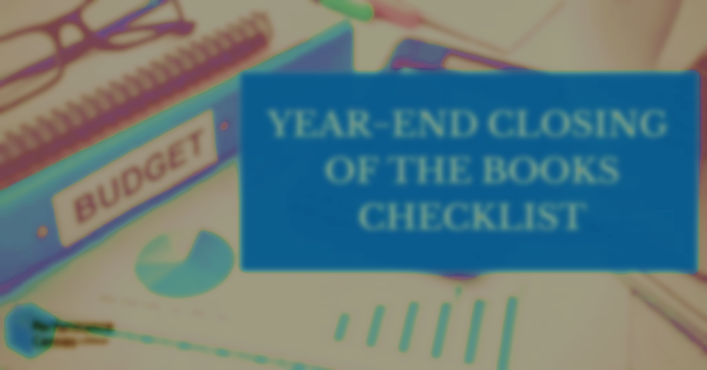
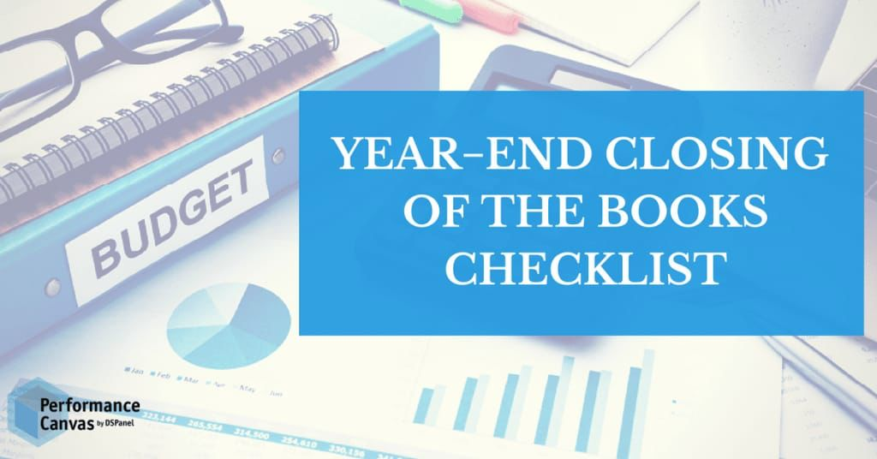
Step-8
Close The Books
Closing the books refers to the process of finalizing the financial records for a specific accounting period.
It involves completing all necessary accounting entries, adjusting balances, and preparing financial statements.
The purpose of closing the books is to summarize the financial activities of the period and reset the accounts for the next accounting period.

Slide 12
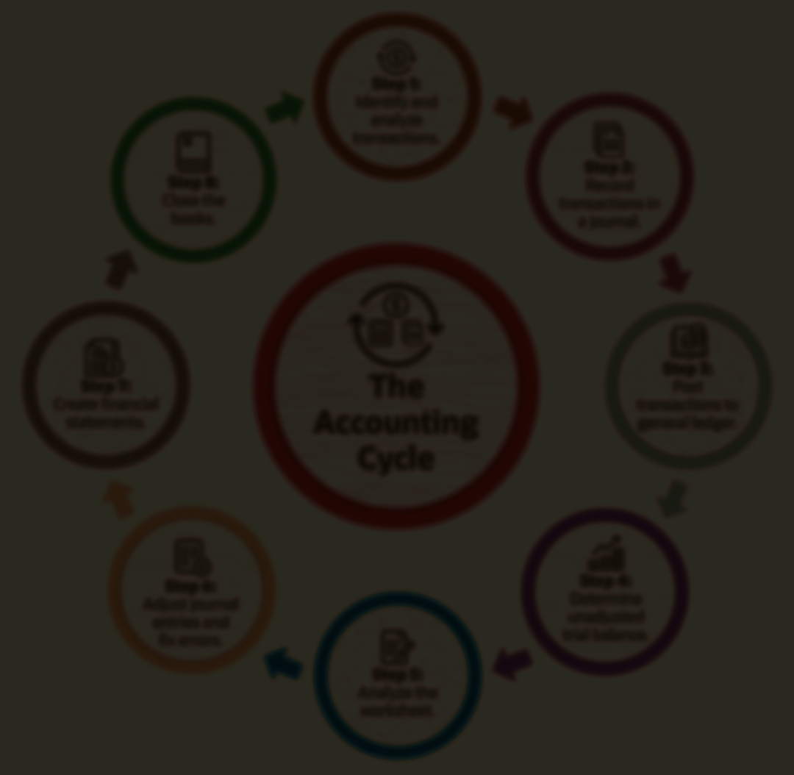
THANKS

